Slide 1
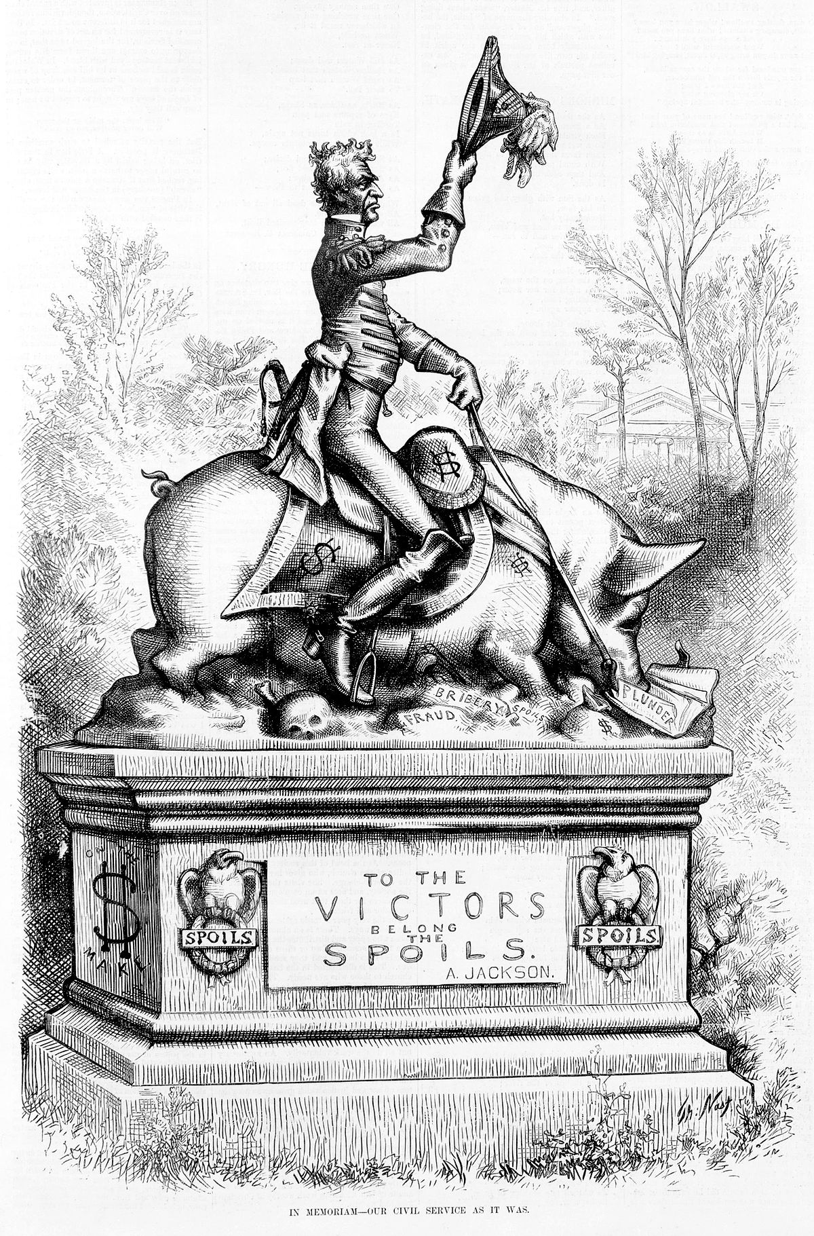
Jackson, Democracy and the Spoils System
1. Increased Suffrage among whites(American History)
2. The Emergence of Andrew Jackson(Andrew Jackson Essays)
3. President of the Common Man (American History)
4. The Spoils System (Andrew Jackson Essays)
5. Party Conventions and the Limits of Democratic Reform (American History)
6. Increased Executive Power (Andrew Jackson Essays)
7. The rise of the west, or the popularization of democracy?(DBP: The “Age of Jackson”)
8. I agree that his presidency signaled the growing power of common people.(DBP: The “Age of Jackson”)
Many believed Jackson’s Spoils System was corrupt and too partisan.
“Jackson was elected by a triumphant majority…. He had the magnetism of command, a powerful will, and indomitable firmness. No American leader ever had more devoted partisans.”(Forty Years of American Life)
Aditya Patel, Period 4

